Slide 1


AI-Powered Affordable Housing Recommendation and Exploration System for Philadelphia
Student Name: Hema Srinivasarangarajan
Course Code and Name: PAF 593 - Applied Project
University Name: Arizona State University Watts College of Public Service and Community Solutions
Instructor Name: Prof. Robert Rowley
Date: 02-Jul-2024

Slide 2


Affordable and Accessible Housing in Philadelphia: A Critical Challenge
Philadelphia faces significant housing challenges:
14% of the population is 65 years or older
16% of residents under 65 have a disability
Severe shortage of suitable housing:
Over 70,000 affordable housing units needed (Philadelphia Housing Authority, 2023)
Only 3% of housing stock both affordable and accessible (Mayor's Commission on Aging, 2022)
Key issues:
Mismatch between affordable and accessible units
Concentration of accessible housing in limited areas
Difficulty for vulnerable populations to find suitable homes

Slide 3
Addressing the Challenge: Our Project Goals
Develop an AI-powered recommendation system for affordable, accessible housing
Utilize machine learning to match users with suitable housing options
Create an interactive tool for exploring housing options
User-friendly interface for both housing seekers and policymakers
Provide data-driven insights for policymakers and urban planners
Identify areas of high need and potential for development
Establish a prototype model adaptable to other urban areas
Create a framework that can be applied to cities facing similar challenges

Slide 4
Our Approach: Data-Driven and AI-Powered
Data Sources:
Census American Community Survey (ACS)
Public Use Microdata Sample (PUMS)
Philadelphia Housing Authority datasets
OpenDataPhilly geospatial information
Data Processing:
Cleaning and standardization
Feature engineering (e.g., accessibility scores, affordability ratios)
Machine Learning:
Random Forest algorithm for housing recommendations
Model trained on 80% of data, tested on 20%
Philadelphia faces significant housing challenges:
14% of the population is 65 years or older
16% of residents under 65 have a disability
Severe shortage of suitable housing:
Over 70,000 affordable housing units needed (Philadelphia Housing Authority, 2023)
Only 3% of housing stock both affordable and accessible (Mayor's Commission on Aging, 2022)
Key issues:
Mismatch between affordable and accessible units
Concentration of accessible housing in limited areas
Difficulty for vulnerable populations to find suitable homes

Slide 5
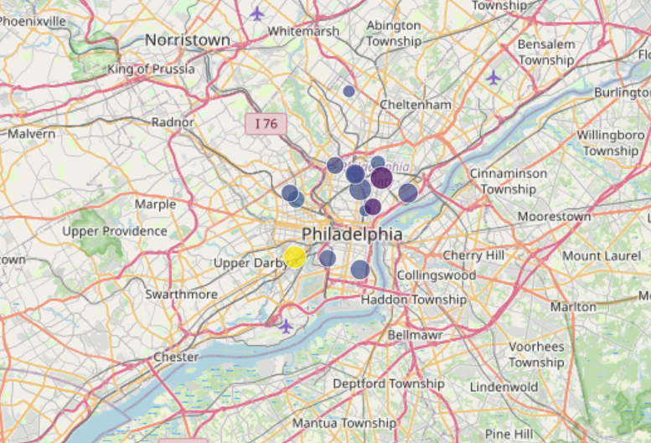
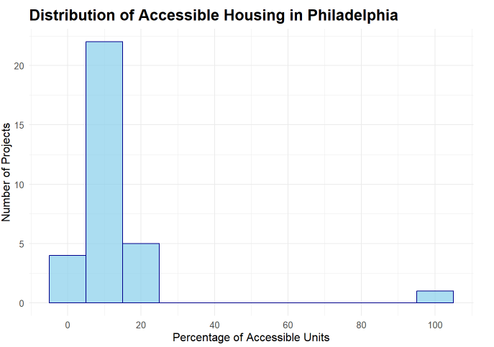
Understanding Philadelphia's Housing Landscape
Distribution of Accessible Housing:
Only 15% of housing units meet basic accessibility criteria
60% of accessible units concentrated in 5 neighborhoods: Center City, University City, Northern Liberties, Fishtown, and Manayunk
Key Finding:
Significant disparity in accessible housing distribution across the city

Slide 6
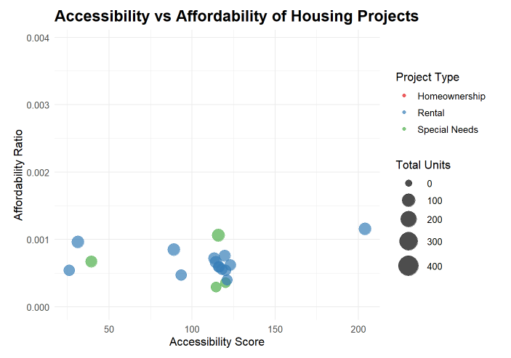
The Accessibility-Affordability Trade-off
Relationship between accessibility and affordability:
Moderate negative correlation (r = -0.42)
Highly accessible units (score > 80) are, on average, 30% more expensive than units with low accessibility scores (score < 20)
Key Insight:
As accessibility increases, affordability tends to decrease
Quantified relationship:
For every 10-point increase in accessibility score, there's an average 7% decrease in affordability
Example: A unit with an accessibility score of 90 is likely to be 21% less affordable than a unit with a score of 60
Implications:
Most accessible units may be out of reach for those who need them most

Slide 7
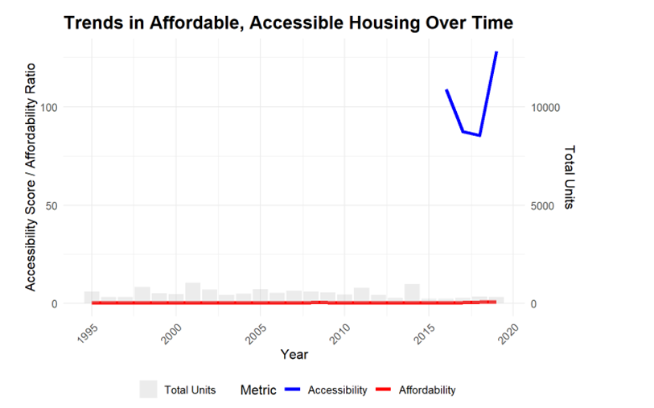
Trends in Affordable and Accessible Housing in Philadelphia Over Time. This graph illustrates changes in housing accessibility (blue line) and affordability (red line) from 1995 to 2019. The gray bars indicate the number of housing units added each year.

Slide 8
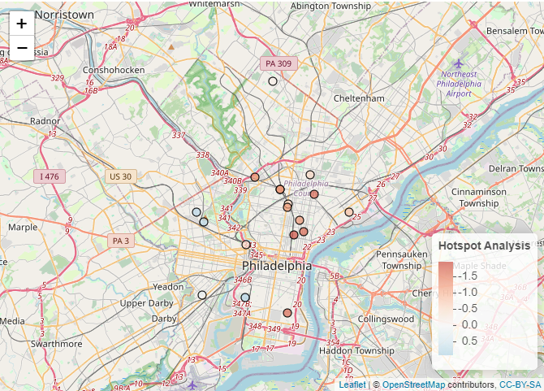
Spatial Analysis: Mapping Accessibility Across Philadelphia
Spatial patterns of accessible housing:
High accessibility clusters in Center City and University City
Low accessibility clusters in older, residential neighborhoods (North and West Philadelphia)
Key Observation:
Clear geographical disparities in housing accessibility
Getis-Ord Gi* hotspot analysis for housing accessibility in Philadelphia

Slide 9
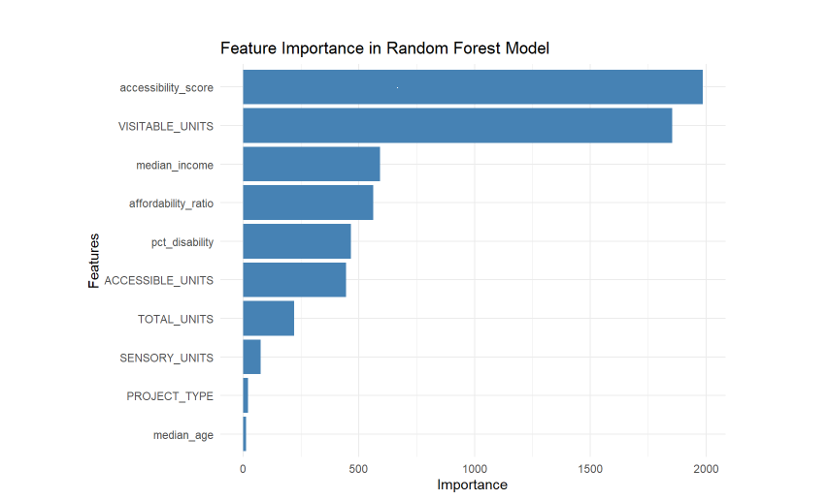
Machine Learning Model Performance
Random Forest Model Performance:
Overall accuracy: 83% on the test set
Root Mean Square Error (RMSE): 0.15
R-squared value: 0.76
Feature Importance:
Accessibility score (25%)
Affordability ratio (22%)
Proximity to public transportation (18%)
Neighborhood safety score (15%)
Distance to healthcare facilities (12%)
Building age (8%)

Slide 10
Machine Learning Model Performance (2)
Key Insight
Multi-faceted Nature of Housing Suitability:
Accessibility (25%) and affordability (22%) are the primary drivers, accounting for nearly half of housing urban planning and community developmentsuitability
Location-based factors collectively contribute 45%:
Proximity to public transportation (18%)
Neighborhood safety (15%)
Distance to healthcare facilities (12%)
This suggests that while physical housing characteristics are crucial, the surrounding environment and infrastructure play an equally important role in determining suitable housing options
Implications for policy: Holistic approach needed, addressing not just housing design but also urban planning and community development

Slide 11
Exploring Philadelphia Housing
· Key Features of the Shiny App:
Interactive map of housing projects
Filters for accessibility score, project type, and total units
Detailed project profiles
Personalized recommendations based on user preferences
· User Benefits:
Easily explore housing options across Philadelphia
Receive tailored recommendations based on specific needs
Gain insights into neighborhood characteristics and amenities
· Demo:
Live URL: https://hema-r-programs.shinyapps.io/PhillyHousingExplorer/

Slide 12
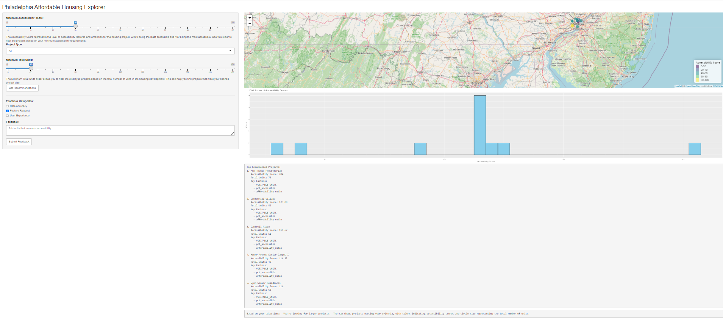
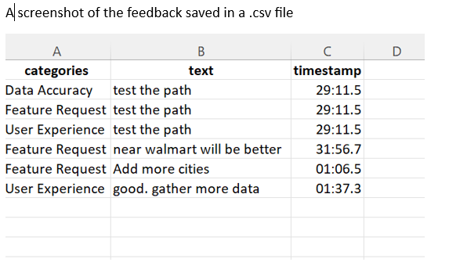

Slide 13
Unveiling Philadelphia's Housing Landscape
· Accessibility-Affordability Trade-off:
30% price premium for highly accessible units
Only 3% of housing stock both affordable and accessible
· Geographical Disparities:
60% of accessible units concentrated in 5 neighborhoods
Clear accessibility deserts in North and West Philadelphia
· Transportation Link:
Strong correlation between accessible housing and proximity to public transit
18% of housing suitability explained by transportation access
· Age and Disability Factors:
14% of population over 65, 16% with disabilities
Current housing stock inadequate to meet growing needs
· AI Model Insights:
83% accuracy in predicting suitable housing
Potential to significantly streamline housing search process

Slide 14

Let’s build bridges to accessibility, one data point at a time.
Thank you

